Slide 1
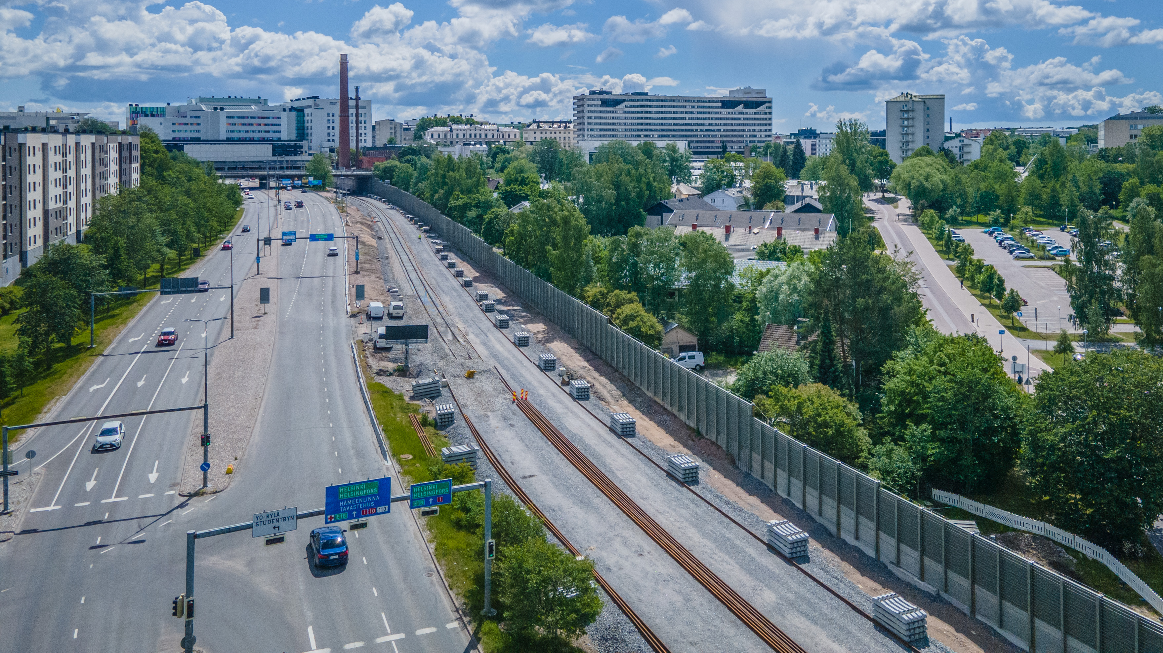
WE ARE THE LARGEST COMPANY PROVIDING INFRASTRUCTURE SERVICES IN FINLAND

Slide 2
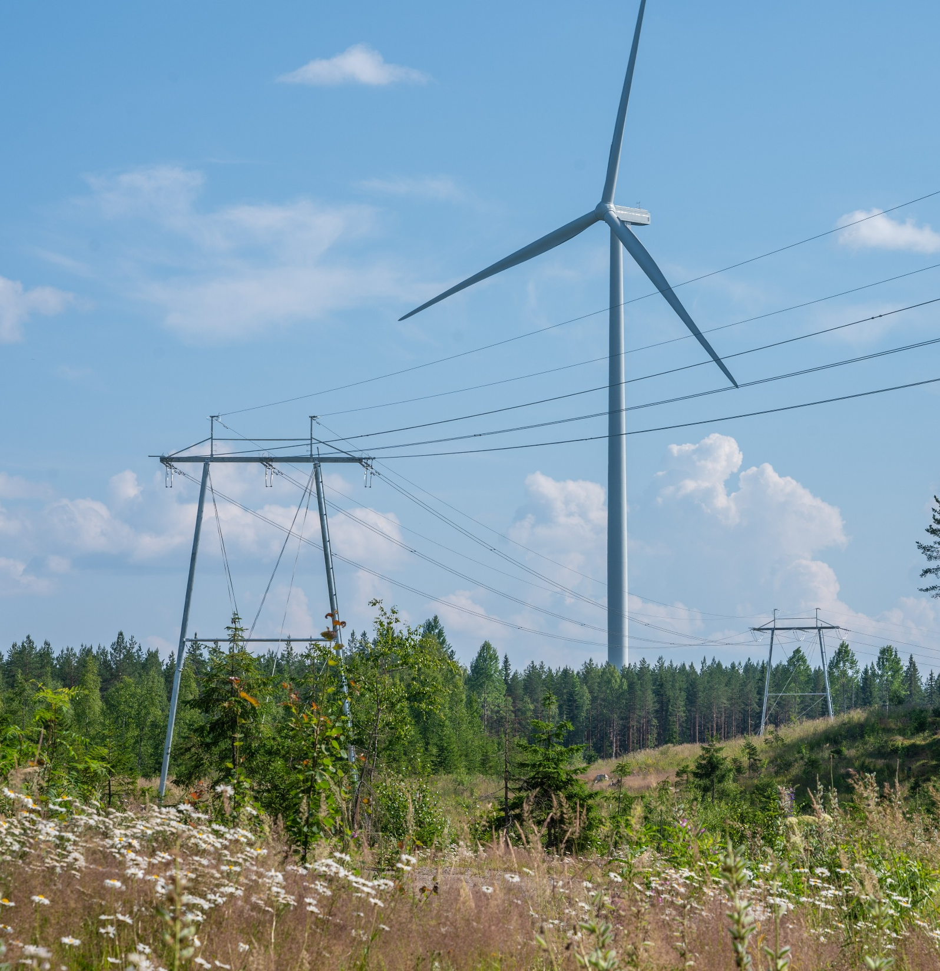


THE LARGEST
COMPANY PROVIDING INFRASTRUCTURE SERVICES IN FINLAND
REVENUE
790
€ million
CUSTOMER SATISFACTION
OCCUPATIONAL SAFETY
66
3.9
Net Promoter Score
accidents per million working hours
”
EMPLOYEE SATISFACTION
PERSONNEL
1,867
51
We do ~1,100 projects per year.
Destia employees
(31 December 2025)
eNPS
2025 figures

Slide 3

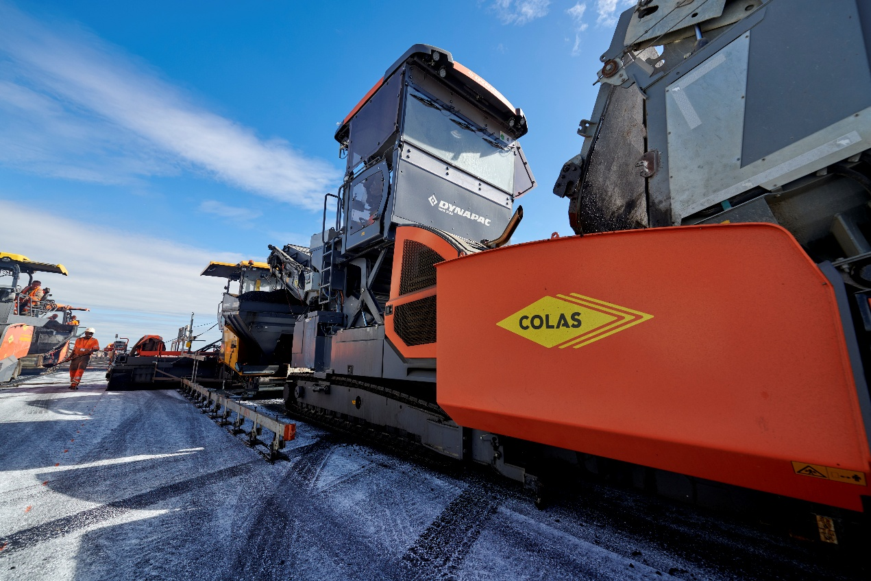
DESTIA’S OWNER
Destia is part of the global Colas Group, owned by a diversified services group Bouygues
Colas is a world leader in the construction and maintenance of transport infrastructure
REVENUE 2025
REVENUE 2025
16.0
56.9
€ billion
€ billion
EMPLOYEES
EMPLOYEES ABOUT
62,000
200,000
OPERATES IN
OPERATES IN AROUND
50
80
countries
countries
2025 figures

Slide 4
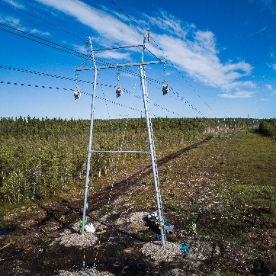
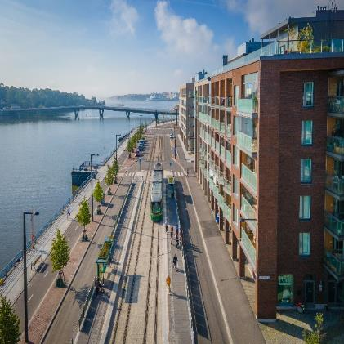
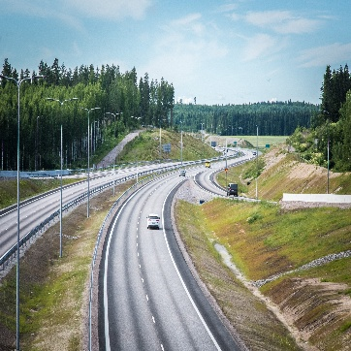
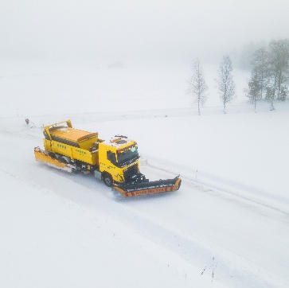
INFRASTRUCTURE FROM DESIGN TO CONSTRUCTION AND FROM MAINTENANCE TO INNOVATION
ENERGY AND INDUSTRIAL SERVICES
RAIL AND URBAN SERVICES
ROAD AND CONSULTING SERVICES
MAINTENANCE SERVICES
Energy networks
Industry and wind power
Transport infrastructure: lighting, electric charging and telematics
Solar power and battery energy storage systems
Energy infrastructure for data centres
Railway construction and maintenance
Light rails
Urban construction
Foundation and rock construction
Aggregates and circular economy
Infrastructure construction for data centres
Road and street construction
Bridges
Infrastructure, urban and traffic design
Infra asset management
Road and street maintenance
Area-wide projects

Slide 5
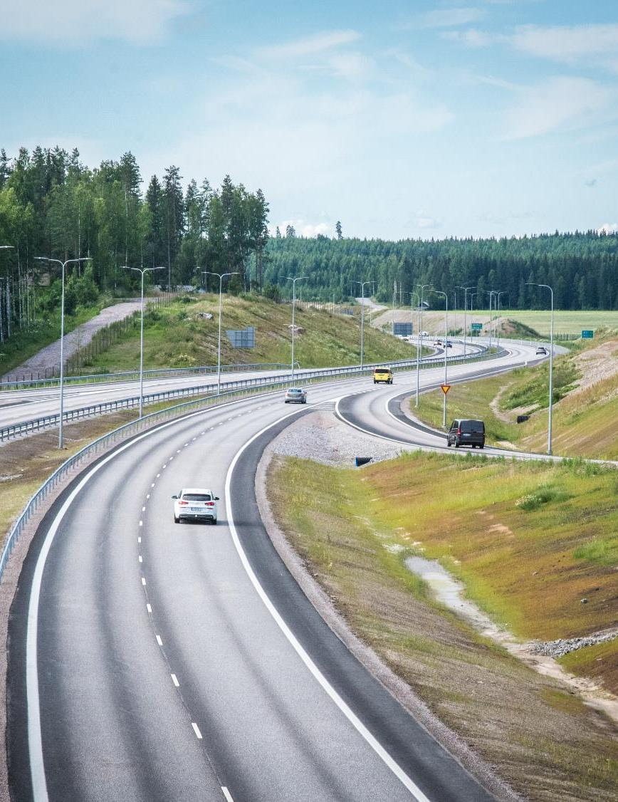
ROAD AND CONSULTING SERVICES
Services from preliminary surveys to measurements and analyses, from design to construction
Our core competence lies in large road and street projects requiring special expertise as well as bridge construction, but we also implement smaller projects
We carry out port structures, airfield-level structures at airports, and preliminary, earthwork and foundation construction projects for the industrial sector
Diverse design services from preliminary surveys to construction design, such as road, street, rail, urban and regional planning as well as traffic, environmental, geotechnical, bridge and rock construction planning
Measurement, survey and quality control services relating to traffic routes and traffic environments
EXAMPLE PROJECTS
Upgrade of E18 Turku Ring Road in the centre of Raisio, alliance project
National Road 4 Konginkangas–Kalaniemi
National Road 4 Kevätlahti–Petomäki, Äänekoski
The renovation of Vuosaari road tunnel
National Road 6 Koria section
Data centres, preconstruction and technical networks
Infrastructure projects for Defence Properties Finland and Finnish Border Guard
National road 4 Kirri–Tikkakoski

Slide 6
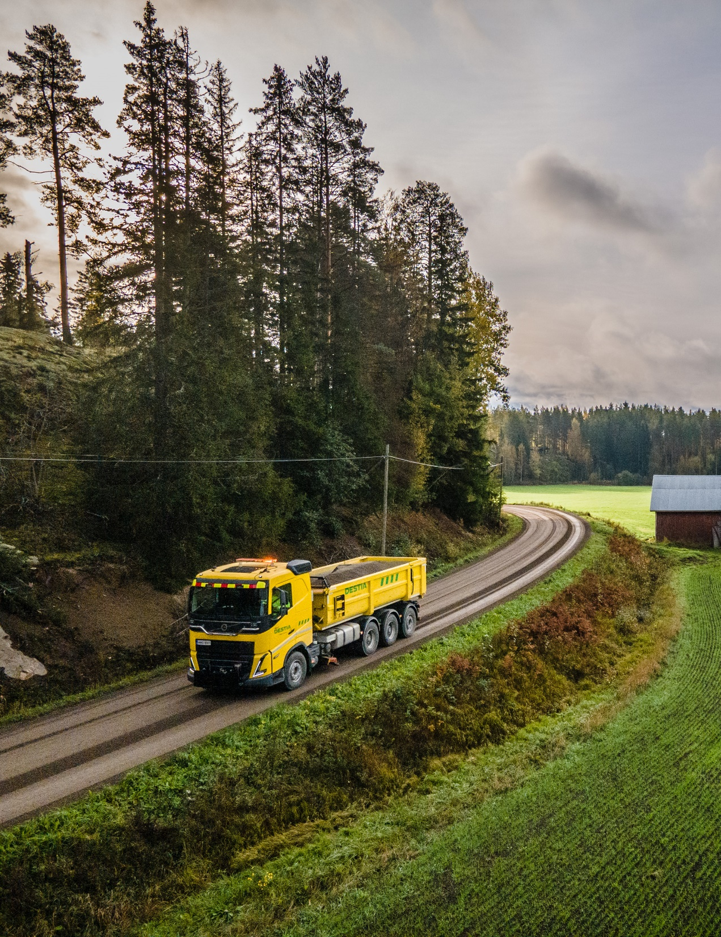
MAINTENANCE SERVICES
The largest road maintenance service provider in Finland
A wide range of services for around-the-year maintenance of traffic routes, gravel roads, bridges and the traffic environment in general
We are experts in winter maintenance
  Our operations are supported by the weather and road condition forecasts provided by the Winter Maintenance Management Centre, a joint operation of Destia and the Finnish Meteorological Institute, and experienced employees utilising modern work methods and equipment
EXAMPLE PROJECTS
Service alliance Desentti in Turku city centre 2019–2027
Espoonlahti and Finnoo city maintenance contract in Espoo 2023-2028
Kuopio Northern maintenance management contract 2021–2027
Maintenance of Raahe SSAB industrial area 2021–2026
Maintenance contract and municipal engineering construction in Varkaus
2026–2033
Porvoo road maintenance contract

Slide 7

RAIL AND URBAN SERVICES
Rail, tramway and metro construction, and Finland’s leading company in the maintenance of superstructures and signalling equipment for railways
Infrastructure construction for data centres
A wide range of services for urban and rock construction
Services for demanding foundation engineering, such as building pits and support, concrete structure work, pile driving and base reinforcement as well as fortification and repair of foundations
Planning and construction of tunnels and underground facilities, such as parking areas, goods and freight stations and civil defence shelters
Open pit and underground mining, concrete structure work, reinforcement, compaction and rock facility fittings
CE certified aggregates
EXAMPLE PROJECTS
Vantaa Light Rail 2024–
Helsinki Urban Development and Light Rail Program, three light rails 2024–
Kouvola–Luumäki superstructure contract 2025-
Hyperscale preconstruction of campuses for an international customer 2024–
Hyperscale data centre infra construction 2025–
Kalasatama–Pasila tramline alliance
Notes:
The term “hyperscale” refers to the scale of projects (large).

Slide 8
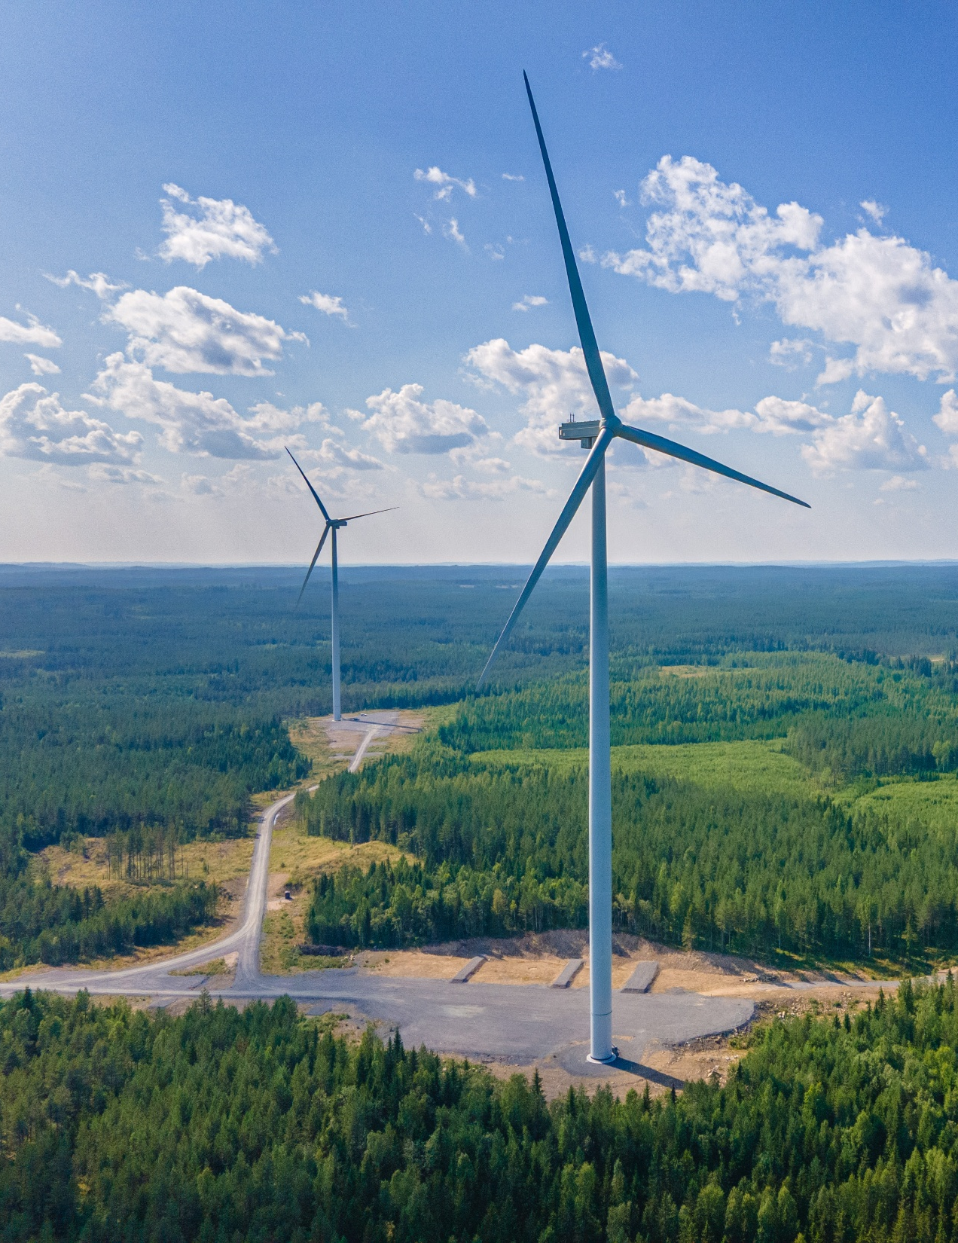
ENERGY AND INDUSTRIAL SERVICES
We seek growth in the energy sector, particularly in renewable energy and electricity grid construction
Design, maintenance and implementation of power lines, electricity networks, substations and wind and solar power infrastructure
Building and maintenance of road lighting, traffic lights and electric vehicle charging infrastructure
Telematics solutions, such as variable speed, warning and information signs, road weather stations and traffic monitoring cameras
House-building construction services for energy projects and industry
EXAMPLE PROJECTS
82 kilometres of 400/100 kV Järvilinja transmission line for Fingrid
Niinimäki wind park area infra for OX2
Synchronous condenser for Fingrid at the Jylkkä substation in Kalajoki
Sinimäki substation for Caruna in Espoo
Delivering 150 charging stations for Helen in Helsinki
Building a battery storage facility in Yllikkälä with Nidec for Neoen
Niinimäki wind park area infra
Notes:
Voimajohtorakentamisessa palvelemme asiakkaita sekä 110 kilovoltin että 400 kilovoltin hankkeissa.

Slide 9
WHAT ARE WE LOOKING FOR?
REQUIREMENTS?
For example:
Steel structure assembly and steel supply
Powerline tower assembly and erection
Concrete works / reinforcement works / molding works
Column stabilisation with machinery
We are interested in all of the above services for projects across all of our business groups
Mandatory Requirements for EU Subcontractors in Finland
Company registration and statutory contractor liability documentation
Valid right to work in Finland for all employees
Posted workers notification to Finnish authorities
A1 certificates or other proof of social security coverage
Finnish tax numbers for construction workers
Compliance with Finnish labour laws and applicable collective agreements
Mandatory insurance and occupational healthcare
Required occupational safety qualifications and site induction
Destia's requirements – No business activities in Russia or Belarus, and neither the company nor its associated persons may be subject to sanctions

Slide 10
